Slide 1
SOA
In detail

Slide 2
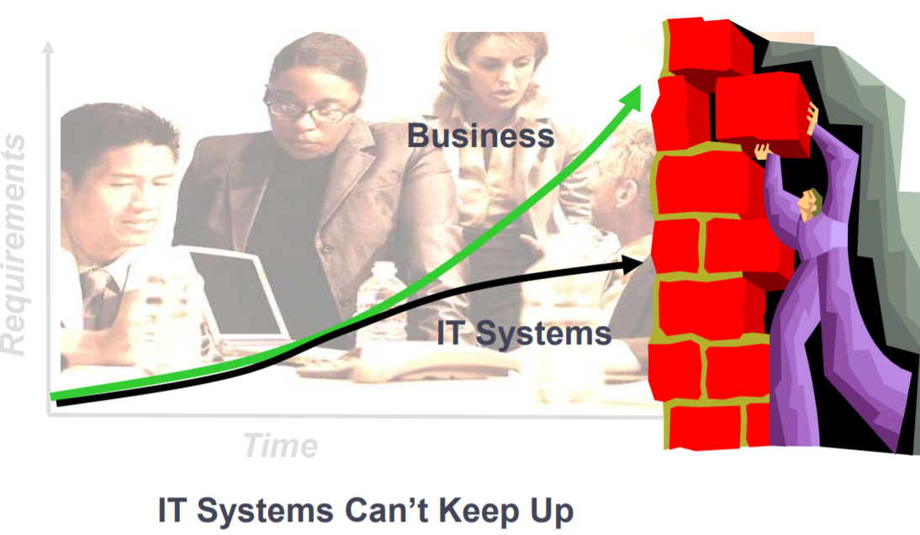
Real challenge on the ground

Slide 3
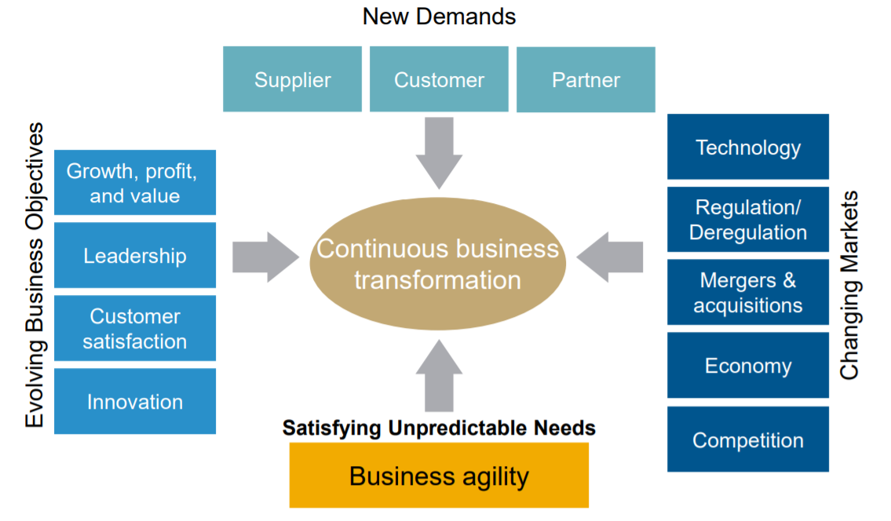
Pressures on the business…

Slide 4
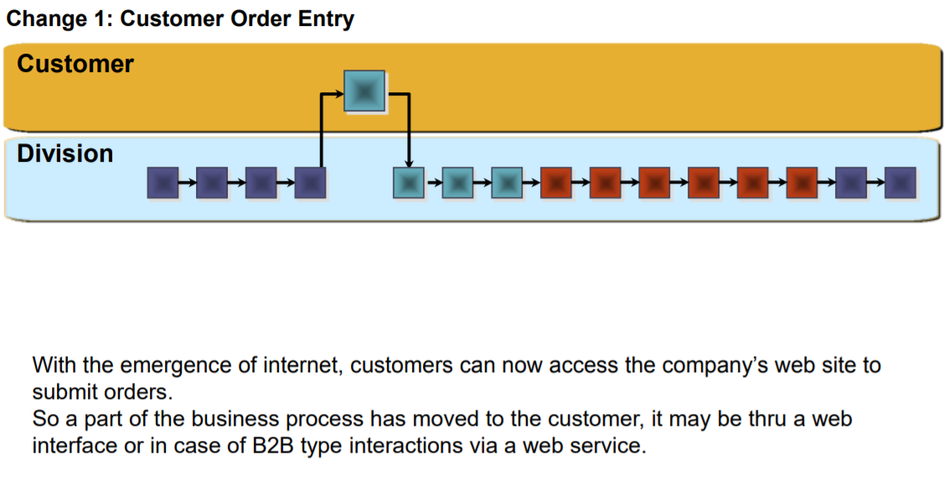

Slide 5
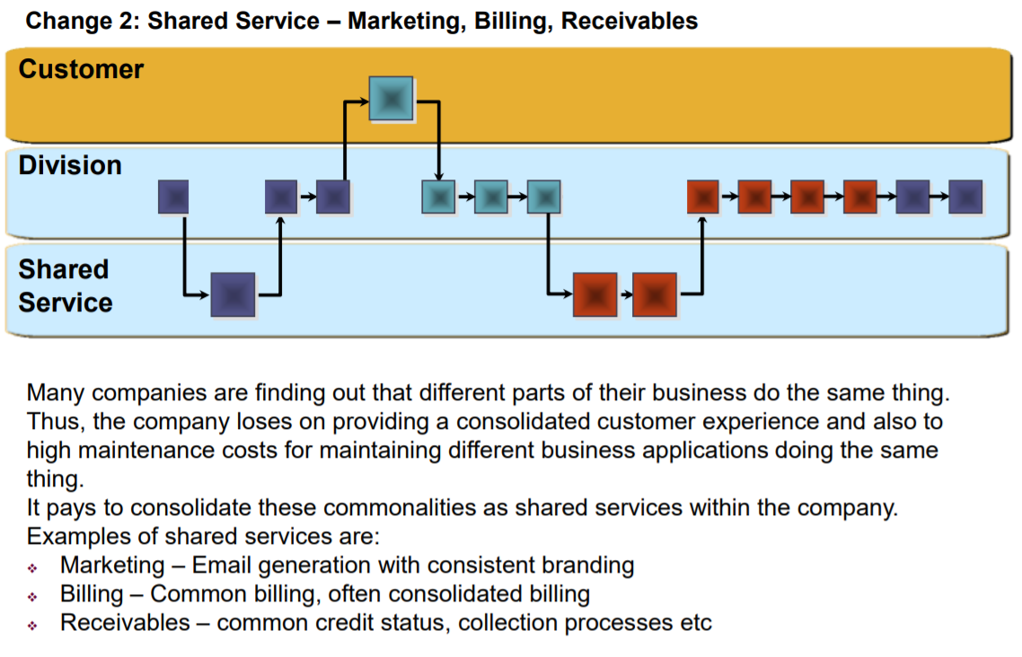

Slide 6
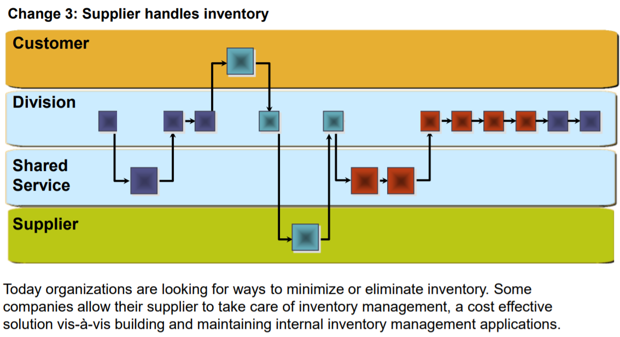

Slide 7
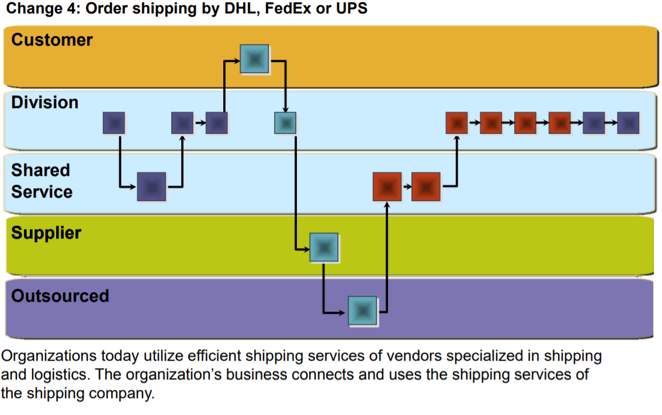

Slide 8
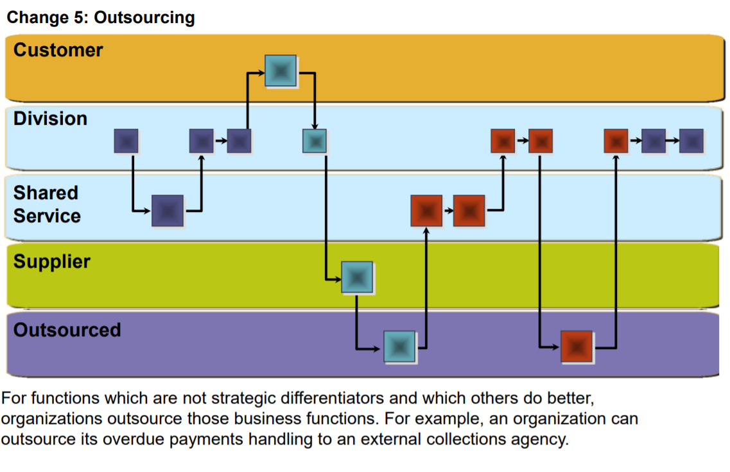

Slide 9
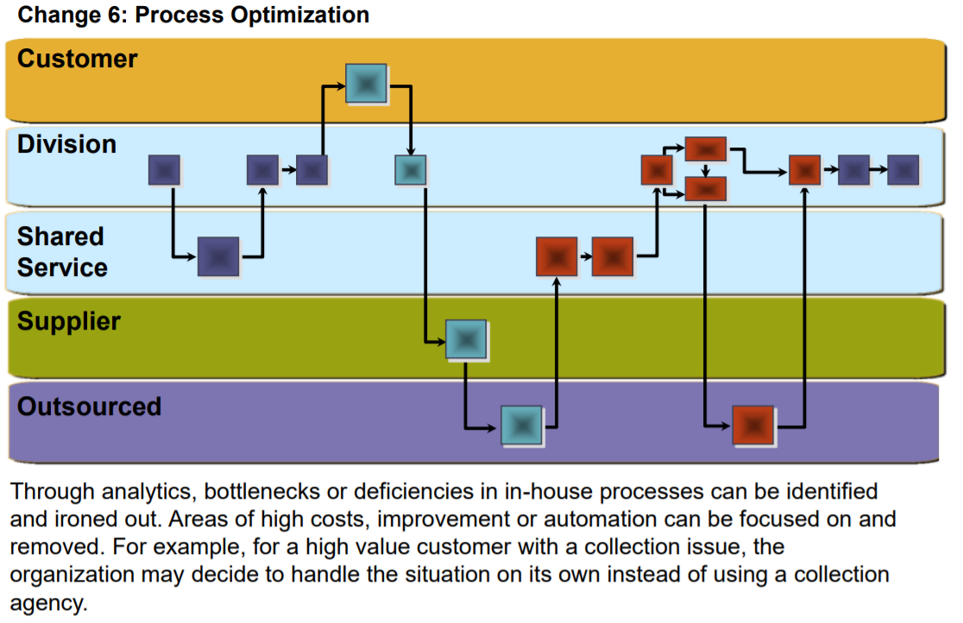

Slide 10
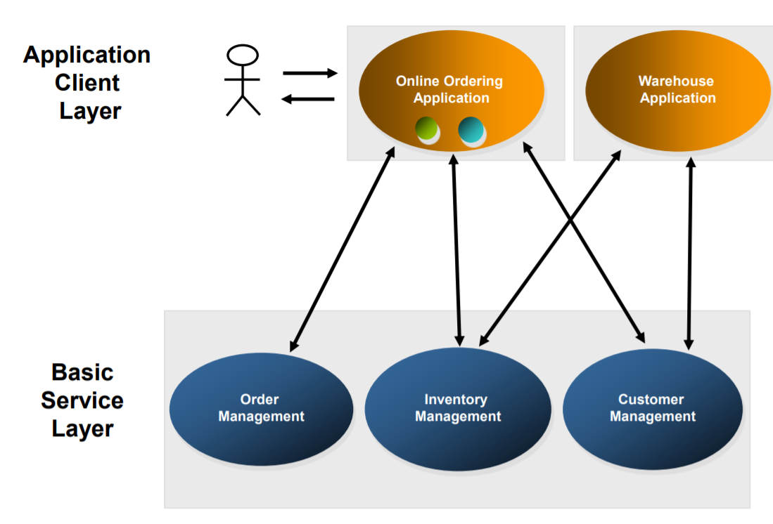
Initial Application Architecture

Slide 11
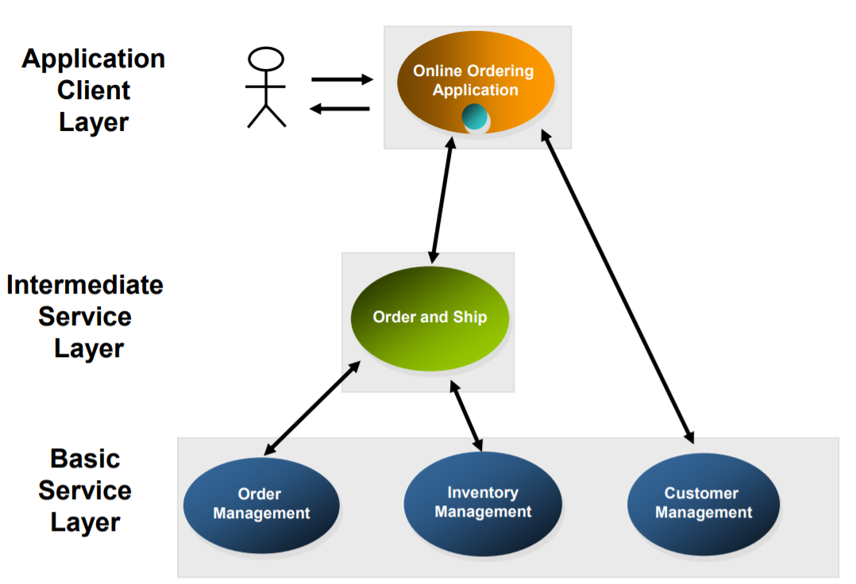
First Application Architecture Upgrade

Slide 12
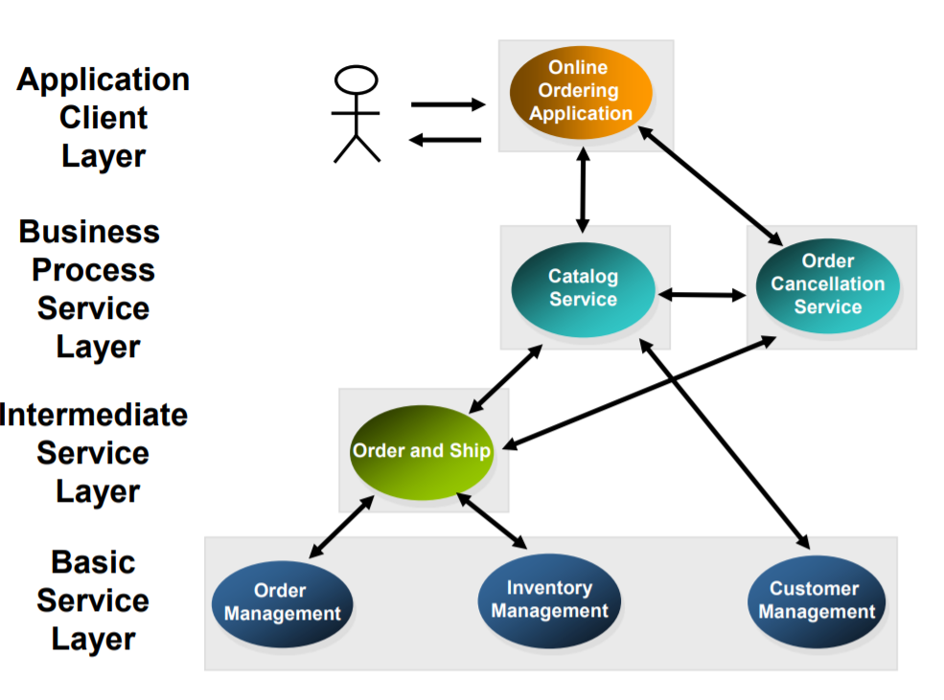
Second Application Architecture Upgrade

Slide 13
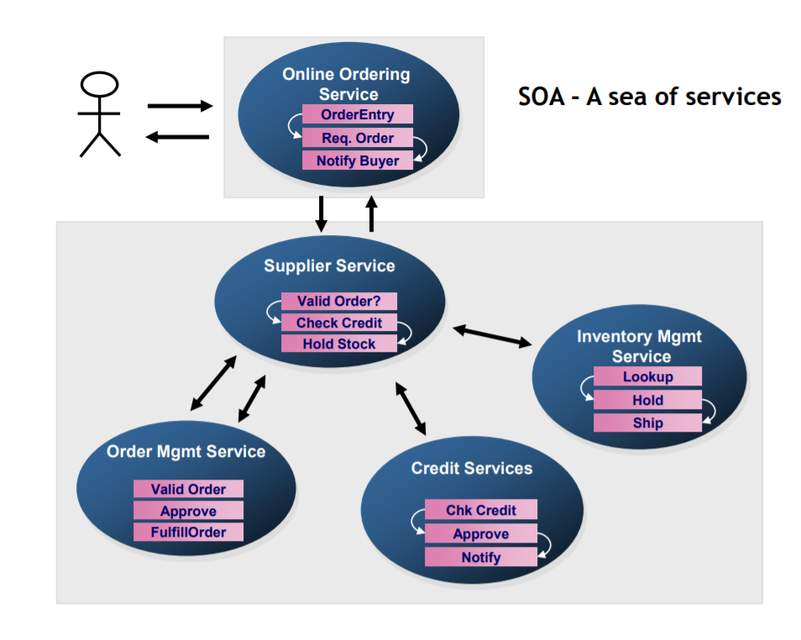
Functional flow diagram

Slide 14
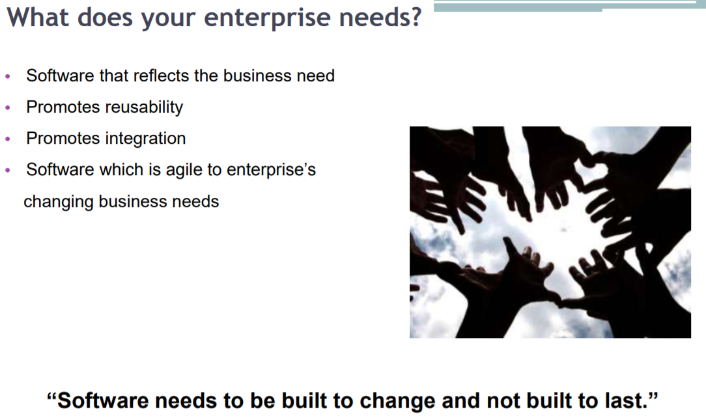

Slide 15
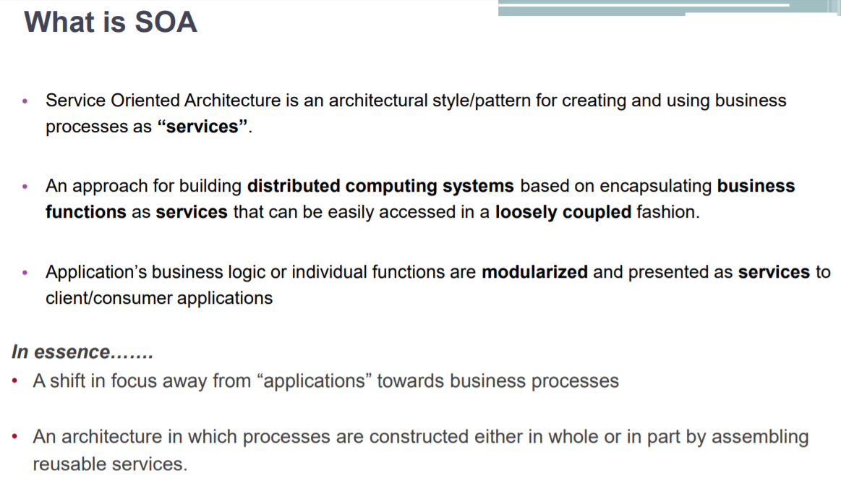

Slide 16
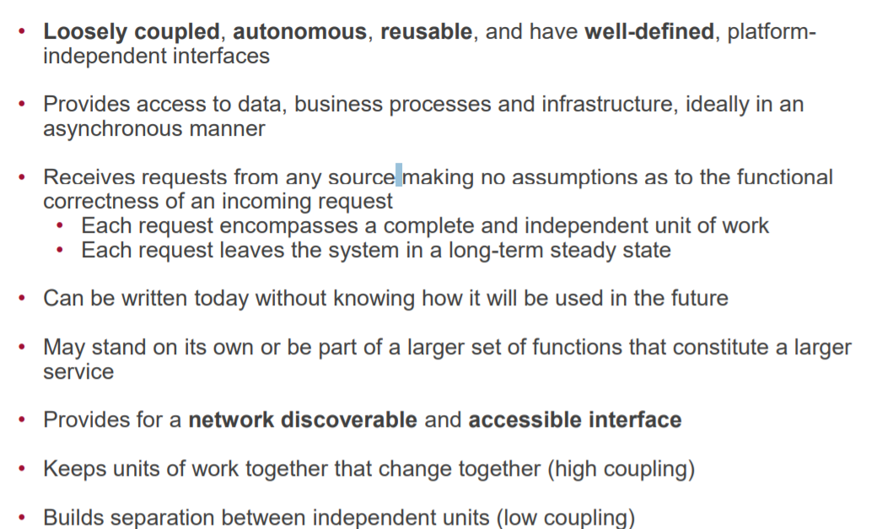
What are services ?

Slide 17
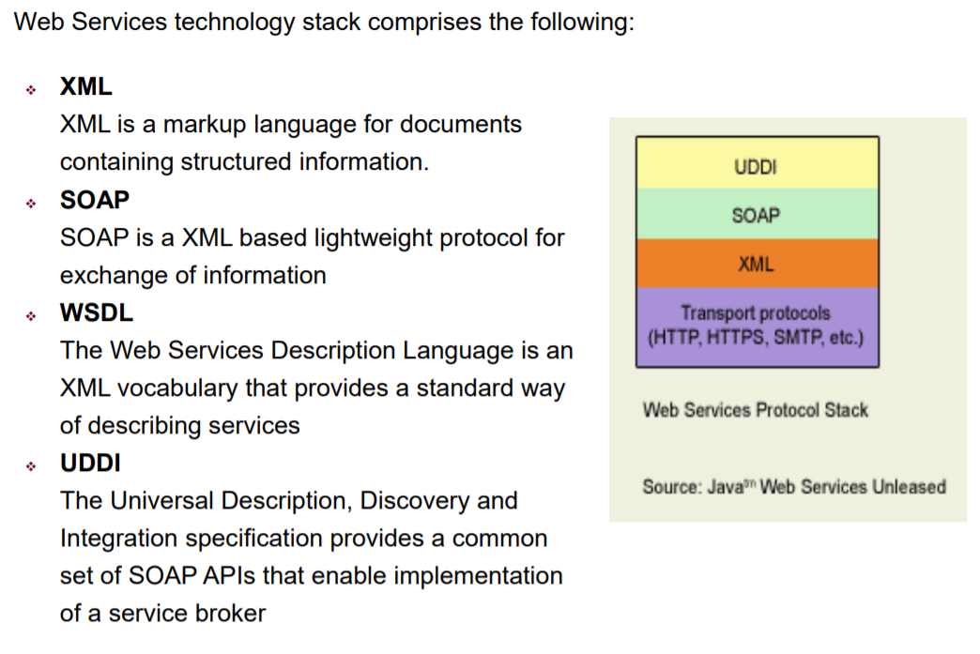
SOA enabling technologies – Web Services

Slide 18
Sample web service use case
Employee Onboarding
Client Onboarding
Vendor Onboarding
Campaign Manager
HR
Finance
Logistics
Email Notification Engine

Slide 19
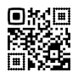
From,
ABC Ltd
Chennai
Ph:12312323
To,
XYZ Ltd
Chennai
Subject : Procurement of computer hardware and network equipment
Dear Sir/Madam,
Your payment has been pending for invoice number 123456. Please help to release the payment as
soon as possible.
Looking forward for the your positive response.
Date : 19th May 2020
Place : Chennai
Your’s faithfully
This is a computer generated statement. Physical signature is required

Slide 20
<message>
<source>
From,
ABC Ltd
Chennai
Ph:12312323
</source>
<destination>
To,
XYZ Ltd
Chennai
</destination>
<Message Header>
Subject : Procurement of computer hardware and network equipment
</Message Header >
<Message Body>
Dear Sir/Madam,
<MessageContent>
Your payment has been pending for invoice number 123456. Please help to release the payment as
soon as possible.
Looking forward for the your positive response.
</ MessageContent >
</Message Body>
<greetings>
</greetings>
Best Regards
<closure>
</closure>
<tracking>
Date : 18th May 2020
</ tracking>
<signature>
</signature>
<disclaimer>This is a computer generated statement. Physical signature is required</disclaimer>
</message>

Slide 21
Final SOAP message
<message>
<source> From, ABC Ltd Chennai Ph:12312323 </source>
<destination> To, XYZ Ltd Chennai </destination>
<messageheader> Subject : Procurement of computer hardware and network equipment </messageheader>
<messagebody>
<greetings>
Dear Sir/Madam,
</greetings>
<messagecontent>
Your payment has been pending for invoice number 123456. Please help to release the payment
as soon as possible.
Looking forward for the your positive response.
</messagecontent>
</messagebody>
<closurenote>Best Regards</closurenote>
<signature>sign.png</signature>
<tracking> Date : 18-05-2020 </tracking>
<disclaimer>This is a computer generated statement.</disclaimer>
</message>

Slide 22
Soap Request message
<?xml version = "1.0"?>
<SOAP-ENV:Envelope
xmlns:SOAP-ENV = "http://www.w3.org/2001/12/soap-envelope"
SOAP-ENV:encodingStyle = "http://www.w3.org/2001/12/soap-encoding">
<SOAP-ENV:Body xmlns:m = "http://www.abc.org/notificationEngine">
<m:SendEnquiry>
<m:source>ABC Ltd Chennai Ph:12312323</m:source>
<m:destination> XYZ Ltd Chennai</m:destination>
<m:messagebody.messageheader>Subject : Procurement of computer hardware and network equipment</m:messagebody.messageheader>
<m:messagebody.greetings>Dear Sir/Madam</m:messagebody.greetings>
<m:messagebody:messagecontent>Your payment has been pending for invoice number 123456. Please help to release the payment as
soon as possible. Looking forward for the your positive response.</m:messagecontent:messagebody>
<m:closurenote>Best Regards</m:closurenote>
<m:signature>sign.png</m:signature>
<m:tracking>18-May-2020</m:tracking>
<m:disclaimer>This is a computer generated statement.</m:disclaimer>
</m:SendEnquiry>
</SOAP-ENV:Body>
</SOAP-ENV:Envelope>

Slide 23
Soap Response message
<?xml version="1.0"?> <soap:Envelope xmlns:soap="http://www.w3.org/2003/05/soap-envelope/" soap:encodingStyle="http://www.w3.org/2003/05/soap-encoding"> <SOAP-ENV:Body xmlns:m = "http://www.abc.org/EmailNotificationEngine"> < m:SendEnquiryResponse> <m:NotificationReferenceId>em123343434343</m:NotificationReferenceId> </ m:SendEnquiryResponse> </soap:Body> </soap:Envelope>

Slide 24
Soap standard template
<?xml version = "1.0"?>
<SOAP-ENV:Envelope
xmlns:SOAP-ENV = "http://www.w3.org/2001/12/soap-envelope"
SOAP-ENV:encodingStyle = "http://www.w3.org/2001/12/soap-encoding">
<SOAP-ENV:Body xmlns:m = "http://www.abc.org/emailnotificationengine">
<m:SendEnquiry>
<m:source>?</m:source>
<m:destination>?</m:destination>
<m:messagebody.messageheader>?</m:messagebody.messageheader>
<m:messagebody.greetings>?</m:messagebody.greetings>
<m:messagebody:messagecontent>?</m:messagecontent:messagebody>
<m:closurenote>?</m:closurenote>
<m:signature>?</m:signature>
<m:tracking>?</m:tracking>
<m:disclaimer>?</m:disclaimer>
</m:SendEnquiry>
< m:SendEnquiryResponse> <m:NotificationReferenceId>?</m:NotificationReferenceId> </ m:SendEnquiryResponse> </soap:Body> </soap:Envelope>

Slide 25
Questions ?
What if the message sent by HR module is missing some parameters ?
How does different Modules know about all the templates supported by other modules ?
How and where does one module send message to other module ?
How is the message secured when it is sent from one module to other module ?
What happens if each of the modules are developed using different technologies i.e. Java, .Net, Nodejs etc… ?
What happens if some of the modules are developed in-house and some are standard products like SAP, Salesforce etc… ?
What is the impact is some of the modules are updated independently ?

Slide 26
Supported faults
<faults>
<source> /* Only registered address are allowed */ </source>
<destination> /* Only registered address are allowed */ </destination>
<messageheader> /* Note valid order reference is allowed */</ messageheader>
<greetings> /* This cannot be null */ </greetings>
<messagecontent> /* This cannot be null */</messagecontent>
<closurenote>/* This cannot be null */</closurenote>
<signature>/* Only QR codes are allowed */</signature>
<tracking> /* Note only date format dd-mm-yyyy allowed */ </ tracking>
<disclaimer></disclaimer>
</faults>

Slide 27
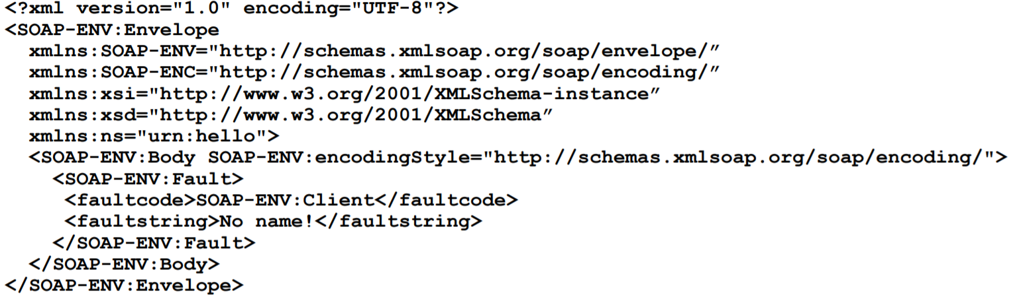
Fault SOAP Message
Invalid Date

Slide 28
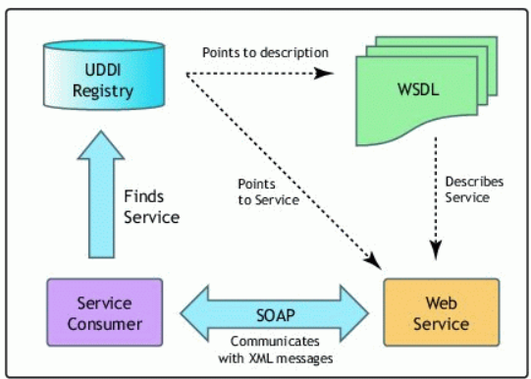
Web Service interactions
Database
Email Notification Engine
Email Notification Engine
Finance
Email Notification Engine

Slide 29
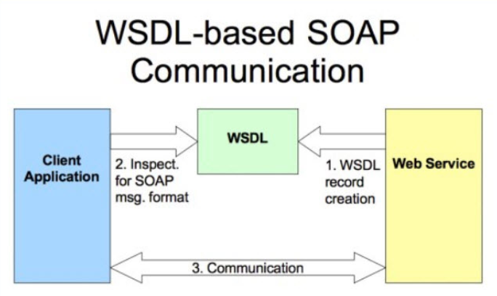
WSDL in action

Slide 30
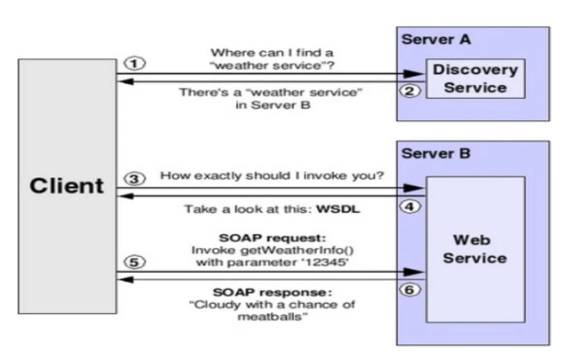
WSDL interactions

Slide 31
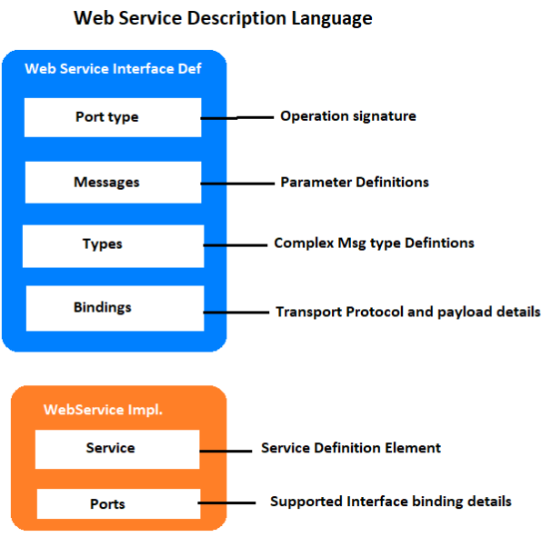
WSDL in detail

